Slide 1
Front End Engineer
Done By : Eng. Salameh Yasin

Slide 2
HTML Introduction
HTML : stand for Hyper Text Markup Language .
Designed to View content over internet Browser Such as : IE, FF , Chrome ….. etc

Slide 3
Doc Type
!DocType HTML5
XHTML
- List all different between HTML Versions

Slide 4
Doc Type
The <!DOCTYPE> declaration helps the browser to display a web page correctly.
HTML5
<!DOCTYPE html>
HTML 4.01
<!DOCTYPE HTML PUBLIC "-//W3C//DTD HTML 4.01 Transitional//EN"
"http://www.w3.org/TR/html4/loose.dtd">

Slide 5
Tag
Any html Tag Is Surrounded by two Tags
<startTag>content</closingTag>

Slide 6
HTML Skeleton
Any HTML tag must be write in html tag like this :
<html>
</html>

Slide 7
HTML Skeleton
Html Document Contain two Parts :
1- Head → not visible to user
2- Body → Visible to user

Slide 8
Head Tag
Inside head tag you can add many things like :
Link to CSS .
Link to javascript .
Meta tags .
Style

Slide 9
Title Tag
<title> Element
Defines a title in browser tool bar .
Provides a title to page when added to favorite .
Displays a title for a page in search engine results .

Slide 10
Base Tag
<base> tag specifies
The <base> tag specifies the base URL/target for all relative URLs in a page:
<head>
<base href="http://www.mineeds.com/images/" target="_blank">
</head>

Slide 11
LinkTag
The <link> tag defines the relationship between a document and an external resource.
<link rel="stylesheet" type="text/css" href="mystyle.css">

Slide 12
The HTML <meta> Element
Metadata is data (information) about data.
The <meta> tag provides metadata about the HTML document. Metadata will not be displayed on the page, but will be machine pars sable.

Slide 13
The HTML <meta> Element
Meta elements are typically used to specify page description, keywords, author of the document, last modified, and other metadata.
The metadata can be used by browsers (how to display content or reload page), search engines (keywords), or other web services.

Slide 14
<meta> Tags - Examples of Use
Define keywords for search engines:
<meta name="keywords" content="HTML, CSS, XML, XHTML, JavaScript">
Define a description of your web page:
<meta name="description" content="Free Web tutorials on HTML and CSS">
Define the author of a page:
<meta name="author" content=“SalamehYasin">
Refresh document every 30 seconds:
<meta http-equiv="refresh" content="30">

Slide 15
The lang Attribute
The language is declared in the lang attribute.
Declaring a language is important for accessibility applications (screen readers)
and search engines:
Example
<!DOCTYPE html>
<html lang="en-US">
<body>
<h1>My First Heading</h1>
</body>
</html>

Slide 16
HTML Encoding (Character Sets)
What is Character Encoding?
ASCII was the first character encoding standard (also called character set). It defines 127 different alphanumeric characters that could be used on the internet.
ASCII supported numbers (0-9), English letters (A-Z), and some special characters like ! $ + - ( ) @ < > .
ANSI (Windows-1252) was the default character set for Windows (up to Windows 95). It supported 256 different codes.

Slide 17
HTML Encoding (Character Sets)
ISO-8859-1, an extension to ASCII, was the default character set for HTML 4. It also supported 256 different codes.
Because ANSI and ISO was too limited, the default character encoding was changed to Unicode (UTF-8) in HTML5.
Unicode covers (almost) all the characters and symbols in the world.

Slide 18
For HTML4:
<meta http-equiv="Content-Type" content="text/html;charset=ISO-8859-1">
For HTML5:
<meta charset="UTF-8">

Slide 19
HTML IDE :
Notepad++
Netbeans
Sublime
Notepad

Slide 20
HTML File Extension :
.html
.htm
Talk about (firebug)

Slide 21
HTML Headings
HTML headings are defined with the <h1> to <h6> tags:
<h1>This is a heading</h1>
<h2>This is a heading</h2>
<h3>This is a heading</h3>

Slide 22
HTML Paragraph
HTML paragraphs are defined with the <p> tag:
<p>This is a paragraph.</p>
<p>This is another paragraph.</p>

Slide 23
HTML Links
HTML links are defined with the <a> tag:
<a href="http://www.w3schools.com">This is a link</a>
Target=“_blank”

Slide 24
HTML Images
HTML images are defined with the <img> tag.
The source file (src), alternative text (alt),
and size (width and height) are provided as attributes:
Example
<img src=“flower.jpg" alt=“flower.com" width="104" height="142“ border=“2”>
Alt is used for screen reader .

Slide 25
HTML Special Tags
<br> : break line .
<hr> : horizantal row .
<u></u> : underlined
<b></b> : bold
<i></i> : italic
<code></code> : like a code no format .
<sub> </sub> : sub script .
<sup></sup> super script
<center></center> : center the elements

Slide 26
HTML Comments
You can add comments to your HTML source by using the following syntax:
<!-- Write your comments here -->

Slide 27
HTML Tables
Tables are defined with the <table> tag.
Tables are divided into table rows with the <tr> tag.
Table rows are divided into table data with the <td> tag.
A table row can also be divided into table headings with the <th> tag

Slide 28
<table border="1">
<tr>
<td>Jill</td>
<td>Smith</td>
<td>50</td>
</tr>
<tr>
<td>Eve</td>
<td>Jackson</td>
<td>94</td>
</tr>
</table>

Slide 29
To add a caption to a table, use the <caption> tag:
<caption>Monthly savings</caption>
ColSpan : to merge columns .
Rowspan : to merge rows .

Slide 30
Lists
Order List .
Unordered List .
Definition List .
Ordered List : <OL type=“A”><li></li></ol>
          Type Attributes :

Slide 31
type="1" | The list items will be numbered with numbers (default)
type="A" | The list items will be numbered with uppercase letters
type="a" | The list items will be numbered with lowercase letters
type="I" | The list items will be numbered with uppercase roman numbers
type="i" | The list items will be numbered with lowercase roman numbers

Slide 32
UL :
Style | Description
list-style-type:disc | The list items will be marked with bullets (default)
list-style-type:circle | The list items will be marked with circles
list-style-type:square | The list items will be marked with squares

Slide 33
Description List :
HTML Description Lists
A description list, is a list of terms, with a description of each term.
The <dl> tag defines a description list.
The <dt> tag defines the term (name),
and the <dd> tag defines the data (description).

Slide 34
Hint :
Nested List

Slide 35
Block Element Vs. Inline Element

Slide 36
Html Layout Div vs. Table

Slide 37
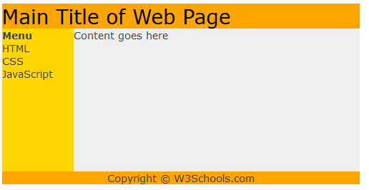

Slide 38
<table style="width:500px;" cellpadding="0" cellspacing="0">
<tr>
;<td colspan="2" style="background-color:#FFA500;">
<h1 style="margin:0;padding:0;">Main Title of Web Page</h1>
</td>
</tr>
<tr>
<td style="background-color:#FFD700;width:100px;vertical-align:top;">
<b>Menu</b><br>
HTML<br>
CSS<br>
JavaScript
</td>
<td style="background-color:#eeeeee;height:200px;width:400px;vertical-align:top;">
Content goes here</td>
</tr>
<tr>
<td colspan="2" style="background-color:#FFA500;text-align:center;">
Copyright © W3Schools.com</td>
</tr>
</table>

Slide 39
HTML FORMS & INPUT
* HTML forms are used to pass data to a server.
* An HTML form can contain input elements like text fields,
checkboxes, radio-buttons, submit buttons and more.A form can also contain
select lists, textarea, fieldset, legend, and label elements.
*

Slide 40
Input Text Field
<input type="text"> defines a one-line input field that a user can enter text into:
First name: <input type="text" name="firstname"><br>
Additional Attributes :
E-mail: <input type="email" name="email" autocomplete="on"><br>
Autocomplete : find the emails in the session

Slide 41
Auto Focus
First name: <input type="text" name="fname" autofocus><br>
it specifies that an <input> element should automatically get
focus when the page loads.
Checked
<input type="checkbox" name="vehicle" value="Car" checked> I have a car
Disabled
Last name: <input type="text" name="lname" disabled><br>

Slide 42
Place Holder :
<input type="text" name="fname" placeholder="First name"><br>
Read Only :
Country: <input type="text" name="country" value="Norway" readonly><br>
Required :
Username: <input type="text" name="usrname" required>

Slide 43
Password Field
<input type="password"> defines a password field:
<form>
Password: <input type="password" name="pwd">
</form>

Slide 44
Radio Buttons
<input type="radio"> defines a radio button. Radio buttons let a user select ONLY
ONE of a limited number of choices:
<form>
<input type="radio" name="sex" value="male">Male<br>
<input type="radio" name="sex" value="female">Female
</form>

Slide 45
Check Boxes
<input type="checkbox"> defines a checkbox. Checkboxes let a user select
ZERO or MORE options of a limited number of choices.
<form>
<input type="checkbox" name="vehicle" value="Bike">I have a bike<br>
<input type="checkbox" name="vehicle" value="Car">I have a car
</form>

Slide 46
Submit
Submit Button
<input type="submit"> defines a submit button.
A submit button is used to send form data to a server.
The data is sent to the page specified in the form's action attribute.
The file defined in the action attribute usually does something with the
received input:
<input type="submit" value="Submit">

Slide 47
Text Area
The <textarea> tag defines a multi-line text input control.
<textarea rows="4" cols="50">
</textarea>

Slide 48
Field List
<form>
<fieldset>
<legend>Personalia:</legend>
Name: <input type="text"><br>
Email: <input type="text"><br>
Date of birth: <input type="text">
</fieldset>
</form>

Slide 49
Select
Create a drop-down list with four options:
<select>
<option value="volvo">Volvo</option>
<option value="saab">Saab</option>
<option value="mercedes">Mercedes</option>
<option value="audi">Audi</option>
</select>

Slide 50
Option Group
Group related options with <optgroup> tags:
<select>
<optgroup label="Swedish Cars">
<option value="volvo">Volvo</option>
<option value="saab">Saab</option>
</optgroup>
<optgroup label="German Cars">
<option value="mercedes">Mercedes</option>
<option value="audi">Audi</option>
</optgroup>
</select>

Slide 51
Button
A clickable button is marked up as follows:
<button type="button">Click Me!</button>

Slide 52
Datalist HTML5
An <input> element with pre-defined values in a <datalist>:
<input list="browsers">
<datalist id="browsers">
<option value="Internet Explorer">
<option value="Firefox">
<option value="Chrome">
<option value="Opera">
<option value="Safari">
</datalist>

Slide 53
IFRAME
<iframe src="demo_iframe.htm" width="200" height="200"></iframe>
<iframe src="demo_iframe.htm" name="iframe_a"></iframe>
<iframe src="demo_iframe.htm" width="200" height="200"></iframe>
<p><a href="http://www.google.com" target="iframe_a">Gooogle.com</a>
</p>

Slide 54
URL - Uniform Resource Locator
Web browsers request pages from web servers by using a URL.
When you click on a link in an HTML page, an underlying <a> tag points to
an address on the web.
A Uniform Resource Locator (URL) is used to address a document
(or other data) on the web.
scheme://host.domain:port/path/filename

Slide 55
Explanation:
scheme - defines the type of Internet service (most common is http)
host - defines the domain host (default host for http is www)
domain - defines the Internet domain name (w3schools.com)
port - defines the port number at the host (default for http is 80)
path - defines a path at the server (If omitted: the root directory of the site)
filename - defines the name of a document or resource

Slide 56
Common URL Schemes
Schema | Short For | Used For
http | HyperText Transfer Protocol | Common web pages. Not encrypted
https | Secure HyperText Transfer Protocol | Secure web pages. Encrypted
ftp | File Transfer Protocol | Downloading or uploading files
file |  | A file on your computer

Slide 57
HTML5 nav
Example
A set of navigation links:
<nav>
<a href="/html/">HTML</a> |
<a href="/css/">CSS</a> |
<a href="/js/">JavaScript</a> |
<a href="/jquery/">jQuery</a>
</nav>

Slide 58
Article TAG
The <article> tag specifies independent, self-contained content.
An article should make sense on its own and it should be possible to distribute it
independently from the rest of the site.
Potential sources for the <article> element:
Forum post
Blog post
News story
Comment

Slide 59
Article Example :
<article>
<h1>Google Chrome</h1>
<p>Google Chrome is a free, open-source web browser developed by Google,
released in 2008.</p>
</article>

Slide 60
Audio Tag
The <audio> tag defines sound, such as music or other audio streams.
Currently, there are 3 supported file formats for the
<audio> element: MP3, Wav, and Ogg
<audio controls>
<source src="horse.ogg" type="audio/ogg">
<source src="horse.mp3" type="audio/mpeg">
Your browser does not support the audio tag.
</audio>

Slide 61
Video
The <video> tag specifies video, such as a movie clip or other video streams.
Currently, there are 3 supported video formats for the
<video> element: MP4, WebM, and Ogg:
<video width="320" height="240" controls>
<source src="movie.mp4" type="video/mp4">
<source src="movie.ogg" type="video/ogg">
Your browser does not support the video tag.
</video>

Slide 62
HTML YouTube Videos
If you want to play a video in a web page, you can upload the video to YouTube
and insert the proper HTML code, in your web page, to display the video:
* Example - Using iFrame
<iframe width="420" height="315"
src="http://www.youtube.com/embed/XGSy3_Czz8k">
</iframe>

Slide 63
Object :
<object width="420" height="315"
data="http://www.youtube.com/v/XGSy3_Czz8k">
</object>
Embed :
<embed width="420" height="315"
src="http://www.youtube.com/v/XGSy3_Czz8k">

Slide 64
Section
The <section> tag defines sections in a document, such as chapters,
headers, footers, or any other sections of the document.
<section>
<h1>WWF</h1>
<p>The World Wide Fund for Nature (WWF) is....</p>
</section>

Slide 65
CSS

Slide 66
What is CSS ?
CSS stands for Cascading Style Sheets
Styles define how to display HTML elements
Styles were added to HTML 4.0 to solve a problem
External Style Sheets can save a lot of work
External Style Sheets are stored in CSS files

Slide 67
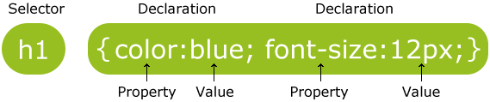
CSS Syntax
A CSS rule set consists of a selector and a declaration block:

Slide 68
Css Example :
p {
color: red;
text-align: center;
}

Slide 69
CSS Comments
Comments are used to explain your code, and may help you when you edit the
source code at a later date. Comments are ignored by browsers.
A CSS comment starts with /* and ends with */.
Comments can also span multiple lines:
/*
*
*
*/

Slide 70
CSS Selectors
1 - The element Selector :
The element selector selects elements based on the element name.
P{
color : red;
}

Slide 71
CSS Selectors
1 - The id Selector :
The id selector uses the id attribute of an HTML tag to find the specific element.
#para{
color : red;
}

Slide 72
CSS Selectors
1 - The Class Selector :
The class selector finds elements with the specific class.
.center{
color : red;
}

Slide 73
CSS Selectors
1 - Grouping Selectors:
h1 {
text-align: center;
color: red;
}
h2 {
text-align: center;
color: red;
}
p {
text-align: center;
color: red;
}

Slide 74
Grouping Selector :
h1, h2, p {
text-align: center;
color: red;
}

Slide 75
Three Ways to Insert CSS
There are three ways of inserting a style sheet:
External style sheet
Internal style sheet
Inline style

Slide 76
External Style Sheet
<head>
<link rel="stylesheet" type="text/css" href="mystyle.css">
</head>

Slide 77
Internal Style sheet
<style>
body {
background-color: lightblue;
}
h1 {
color: navy;
margin-left: 20px;
}
</style>

Slide 78
Inline Style Sheet
<h1 style="color:blue;margin-left:30px;">This is a heading.</h1>

Slide 79
Cascading order
Browser default
External style sheet
Internal style sheet (in the head section)
Inline style (inside an HTML element)
!important tag : to prevent over write

Slide 80
CSS Background
CSS background properties are used to define the background effects of
an element.
CSS properties used for background effects:
background-color
background-image
background-repeat
background-attachment
background-position

Slide 81
Background Color
body {
background-color: #b0c4de;
}

Slide 82
Color Specified in CSS As :
a HEX value - like "#ff0000"
an RGB value - like "rgb(255,0,0)"
a color name - like "red"
Color Picker :
http://www.w3schools.com/tags/ref_colorpicker.asp

Slide 83
background-image
body {
background-image: url("paper.gif");
}
Background Repeat : background-repeat: repeat-x;
background-position: right top;

Slide 84
Background - Shorthand property
body {
background: #ffffff url("img_tree.png") no-repeat right top;
}

Slide 85
Background Attachment
The background-attachment property sets whether a background image is fixed
or scrolls with the rest of the page.
body {
background-image: url('w3css.gif');
background-repeat: no-repeat;
background-attachment: fixed;
}

Slide 86
Background Position :
How to position a background-image:
background-position: center;

Slide 87
text formatting
Text Color :
The color property is used to set the color of the text.
Color : blue;
Text Alignment :
The text-align property is used to set the horizontal alignment of a text.
text-align: center; {left, right, justify }

Slide 88
text formatting
Text Decoration :
The text-decoration property is used to set or remove decorations from text.
text-decoration: none; {overline, line-through, underline}
Text Transformation :
The text-transform property is used to specify uppercase and lowercase letters in a text.
text-transform: uppercase; {lowercase, capitalize}

Slide 89
text formatting
letter-spacing :
The letter-spacing property increases or decreases the space between characters in a text.
letter-spacing: 2px;
Line-Height :
Specify the space between the lines in two paragraphs
line-height: 10px;

Slide 90
text formatting
text-shadow :
The text-shadow property applies shadow to text.
text-shadow: 2px 2px #ff0000;
word-spacing:
Specify that the space between words in <p> elements should be 30 pixels:
word-spacing: 30px;

Slide 91
CSS Font
Font Family :
The font family of a text is set with the font-family property.
font-family: "Times New Roman", Times, serif;
Font Style:
The font-style property is mostly used to specify italic text.
font-style: normal; {italic}

Slide 92
CSS Font
Font Size :
The font-size property sets the size of the text.
font-size: 40px;
font-weight :
font-weight: normal; {bold,bolder, 100-900}

Slide 93
CSS Link
links can be styled differently depending on what state they are in.
The four links states are:
a:link - a normal, unvisited link
a:visited - a link the user has visited
a:hover - a link when the user mouses over it
a:active - a link the moment it is clicked

Slide 94
/* unvisited link */
a:link {
color: #FF0000;
}
/* visited link */
a:visited {
color: #00FF00;
}
/* mouse over link */
a:hover {
color: #FF00FF;
}
/* selected link */
a:active {
color: #0000FF;
}

Slide 95
Lists
list-style-type: circle; {square, upper-roman, lower-alpha }
list-style-image: url('sqpurple.gif');

Slide 96
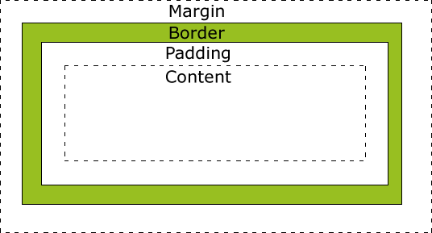

Slide 97
CSS Border Properties
The CSS border properties allow you to specify the style, size, and color of
an element's border.
border: 5px solid red;
Dotted
Dashed
Solid
double

Slide 98
Hiding an Element - display:none or visibility:hidden
visibility: hidden;
display: none;
display: inline;
display: block;

Slide 99
Position
Static Positioning :
HTML elements are positioned static by default. A static positioned element is
always positioned according to the normal flow of the page.
p.pos_fixed {
position: fixed;
top: 30px;
right: 5px;
}

Slide 100
Relative Positioning
A relative positioned element is positioned relative to its normal position.
h2.pos_left {
position: relative;
left: -20px;
}

Slide 101
Absolute Positioning
An absolute position element is positioned relative to the first parent element that
has a position other than static. If no such element is found,
the containing block is <html>:
h2 {
position: absolute;
left: 100px;
top: 150px;
}

Slide 102
Z-index
Overlapping Elements
The z-index property specifies the stack order of an element
(which element should be placed in front of, or behind, the others).

Slide 103
What is CSS Float?
With CSS float, an element can be pushed to the left or right, allowing other
elements to wrap around it.
Float is very often used for images, but it is also useful when working with layouts.
Float Left.
Float right
Clear

Slide 104
CSS Image Opacity
Creating transparent images with CSS is easy.
The CSS opacity property is a part of the W3C CSS3 recommendation.
img {
opacity: 0.4;
filter: alpha(opacity=40); /* For IE8 and earlier */
}

Slide 105
CSS Image Opacity
Creating transparent images with CSS is easy.
The CSS opacity property is a part of the W3C CSS3 recommendation.
img {
opacity: 0.4;
filter: alpha(opacity=40); /* For IE8 and earlier */
}

Slide 106


Slide 107
Start working on boot strap
Download it from the website .
you need to include all the appropriate files and follow a proper HTML structure.
<link rel=”stylesheet” href=”css/bootstrap.css” type=”text/css”/>
<script src="http://code.jquery.com/jquery-1.10.1.min.js"></script>
<script src=”js/bootstrap.js”></script>

Slide 108
Understanding how it works
Twitter Bootstrap is largely dependent on 12 grids.
what are grids?
Suppose you want two large equal divisions inside the body of your index.html.
You have to give a class of “span6” to each of div element.
This tells Bootstrap to make two equal divisions that should span six grids
on each side. Hopefully, this gives you an idea of how Bootstrap works.
It has a set of predefined classes for each element. You have to give
appropriate classes to each when needed.

Slide 109
Lets build This Page !!
http://www.zetiz.com/sitepoint/
http://www.sitepoint.com/twitter-bootstrap-tutorial-handling-complex-designs/

Slide 110
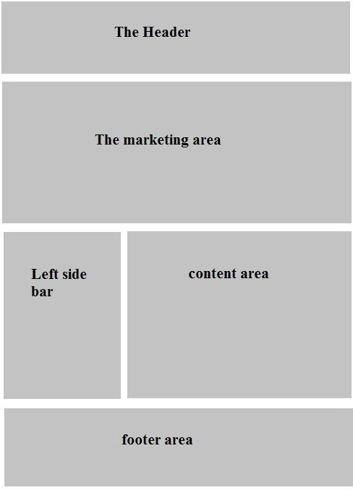

Slide 111
JQuery
Done By : Salameh Yasin

Slide 112
What is jQuery?
jQuery is a lightweight, "write less, do more", JavaScript library.
The purpose of jQuery is to make it much easier to use JavaScript on your website.

Slide 113
jQuery Install
1) Internal : go to jquer website and include it to your code like external css :
<script src="jquery-1.11.1.min.js"></script>

Slide 114
2) External : include it from Google
<script src="http://ajax.aspnetcdn.com/ajax/jQuery/jquery-1.11.1.min.js"></script>

Slide 115
Document.ready function
<script type="text/javascript">
$("document").ready(function(){
alert('welcome to jquery ');
});
</script>

Slide 116
JQuery Selectors & Filters
Select Content from document and manipulate it .

Slide 117
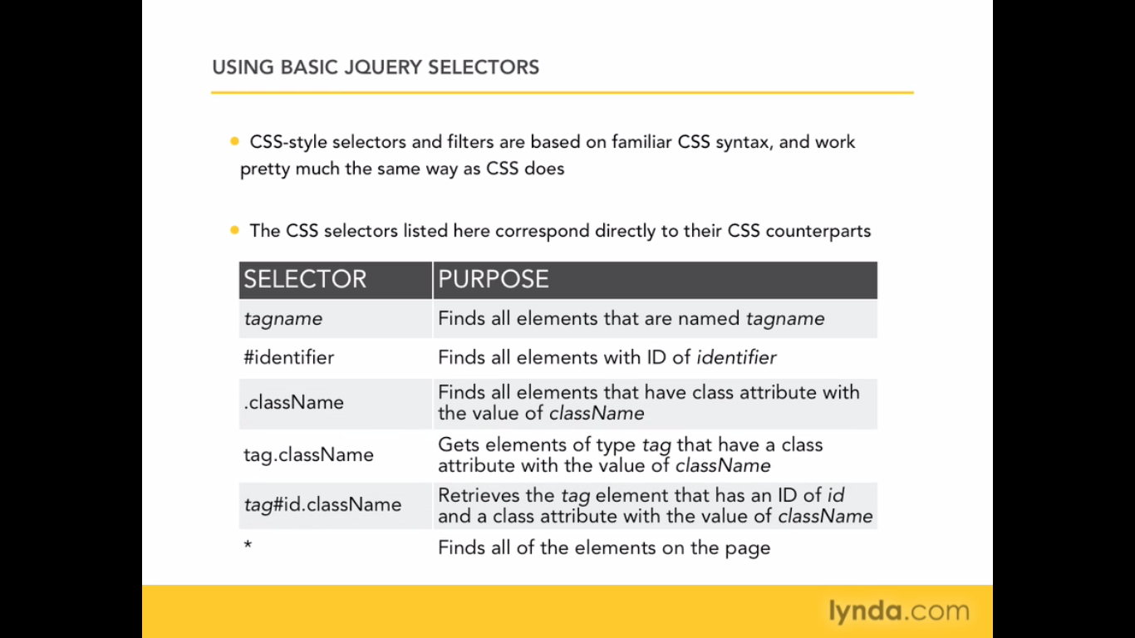
JQuery Selectors

Slide 118
Get Elements
Ex1: Get All P element in html :
$(“p”);
Ex1: Get tag with ID(“#list1”)
$(“#list1”);
$(“li.a”); // get all element with class a

Slide 119
Get Elements in DOM
Document.getElementByTagName(“p”)

Slide 120
Ex3: Get all <li> with Class a:
$(“li.a”).

Slide 121
Example to add class
$(“document”).ready(function(){
$(“p”).css(“border” , “3px solid red”);
});
// this jquery code will add a css style to all p in the page .

Slide 122
Assignment :
Try all selectors we study it before ?
1) change the style of specific tag .
2) change the style off current class
3) change the style of the current ID.
4) change style of tag have specific class.
5) change style of tag have specific id

Slide 123
JQuery Filters :
Works with Selectors to find a specific element of that selector .
- filters working with selectors.

Slide 124
Filters Type :
Filter | Purpose
:first | select first element of selector
:last | select last element of selector
:odd | select odd elements of selector
:even | select even elements of selector
:header | select all headers element(h1 - h6)
:not(selector) | Include element donot match selector

Slide 125
Filters Examples :
$("p:first").css("border", "1px solid green");
$("p:last").css("border", "2px dotted green");
$("p:even").css("color", "blue");

Slide 126
Assignment :
Try to make all selectors by your self
Try to make table example (rows in different colors).

Slide 127
Attribute selector :
$(“p[class]”).css(); // this will select all paragraph have class .
$(“p[id=para]”).css(); // this will select all paragraph have id = para .

Slide 128
$(“p[id^=para]”).css(); // this will select all paragraph start with para like (para1,para2,....) .

Slide 129
Form Selectors :
you can use form selector to deal with form element .
they look like other selector but start with (:)

Slide 130
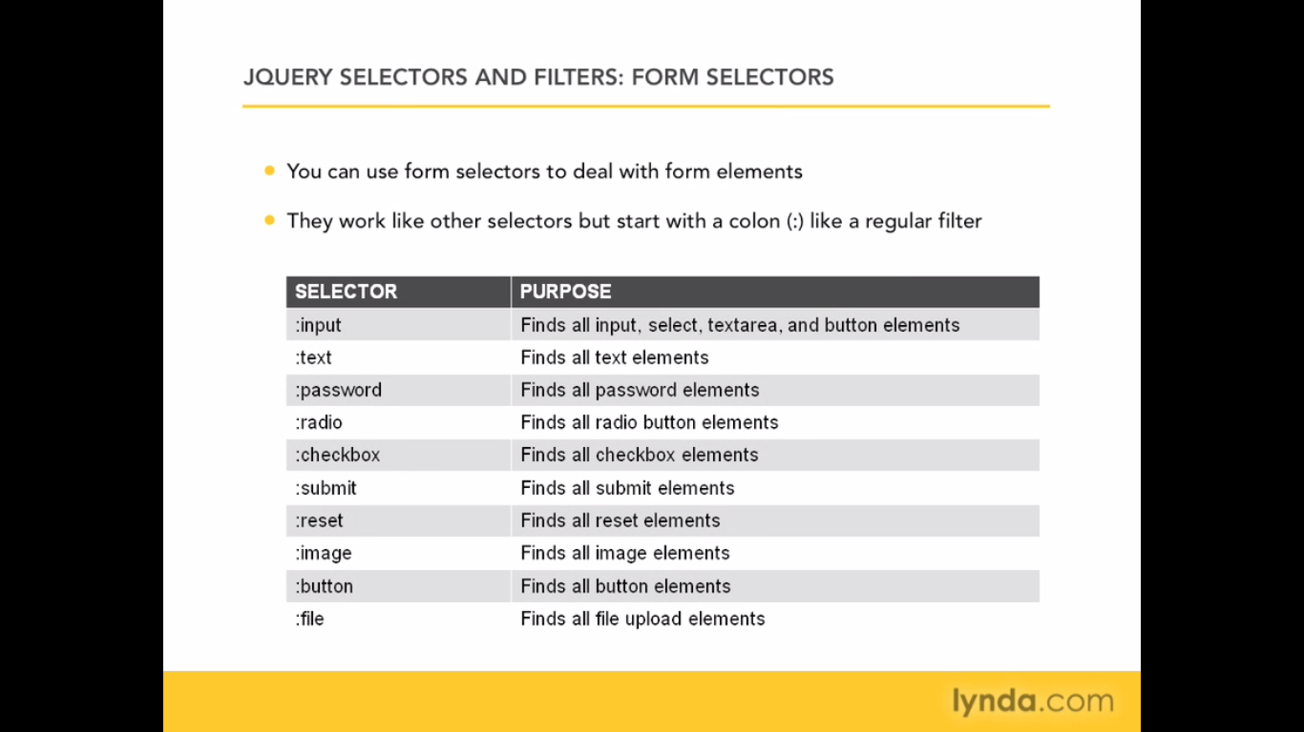

Slide 131
$(“document”).ready(function(){
$(“:input”).css(“border” , “3px solid red”);
});
$(“form :input”) // select all input in a form

Slide 132
Assignment ?
1) make a form cover all elements
2) Try to use all selectors

Slide 133
JQUERY Traversing
Length // get number of elements
ex : alert($("p").length);
Size // the same
Find // will find element inside element
$("p").find("span.ss").css("border","4px solid #000");

Slide 134
Each() function loop
Var border = 3;
Var leftmargin = 0;
$("p").each(function() {
$(this).css("border", border+"px solid red");
$(this).css("margin-left", leftmargin);
});

Slide 135
Html Content in Jquery
You Can manipulate and Access to html element by using JQuery so Easily .

Slide 136
Creating setting and get content
function | purpose
html() | Return the html content of first matched element
html(new content) | Set the matched html to new content
text() | Return the text of matching element
text(new text) | Set new text

Slide 137
Get HTML Value :
$(“document”).ready(function(){
alert($("#sam").html());
});
// this will alert the content of ID sam

Slide 138
Change Html Content
$(“document”).ready(function(){
$("#sam").html(“<h1>New Content </h1>”);
});
// this will change the content of the id .

Slide 139
Add content to HTML Tag
$(“document”).ready(function(){
var newItem = $(“<p>New Item is here</p>”);
$(“#sam”).html(newItem.html());
});
// this will add the new content to existing id .

Slide 140
Assignment
Change the text to the last paragraph you have it .

Slide 141
Add attribute to HTML
you can add new attribute to existing html element .
in this example i will add “_blank” attribute to existing link

Slide 142
Add attribute
$(“document”).ready(function(){
$(“a”).attr(“target”, “_blank”);
});
// this will add blank target to existing Anchor Tag .

Slide 143
Remove attribute
$(“document”).ready(function(){
$(“a”).removeAttr(“href”);
});
// this will remove href from Anchor Tag .

Slide 144
Add many attributes :
$(“document”).ready(function(){
$(“img”).attr({src:”images/flower.jpg”, alt:”flower”});
});
// this add new image tag

Slide 145
Append
The append function will add new content to existing html tag like :
$(“p”).append(“this is new text”);
// this text will be added to the end of each paragraph .

Slide 146
Prepend
Prepend will add text before existing text
$(“p”).prepend(“this is new text”);
// this text will be added to the first of each paragraph .

Slide 147
Animation
Showing hiding elements .
Fading hiding in out
Moving element in the screen

Slide 148
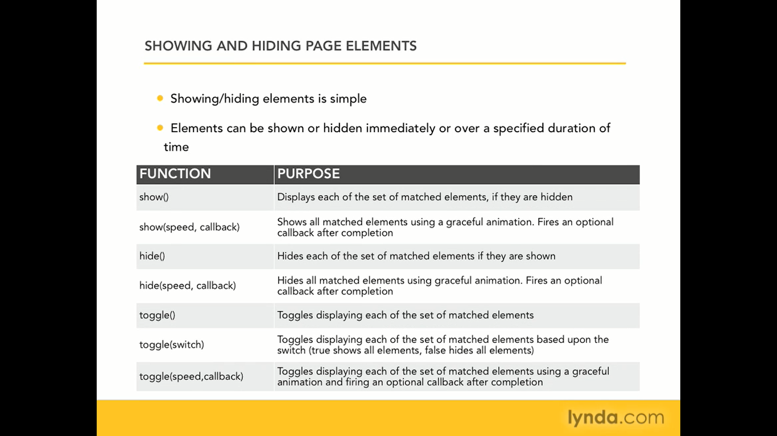

Slide 149
Hide /show
See the example in the hide and show example .
// this for callback function
$(“#thediv”).show(5000,function(){
alert(“done showing”);
});

Slide 150
Fadding
Fadein(speed,callback);
Fadeout(speed,callback);
Fadeto(speed,opacity,callback)
See the example of fade

Slide 151
Sliding
Sliding the specific element
Slideup();
Slidedown()

Slide 152
Custom animation
See the file animation

Slide 153
JQUERY UI
DRAGGABLE
RESIZABLE
SORTABLE
ACCORDION
AUTO COMPLETE
DATE PICKER
DIALOG BOX
MENU
SLIDER
TABS
TOOLTIP

